Slide 1
Symbol-Based Machine Learning

Slide 2
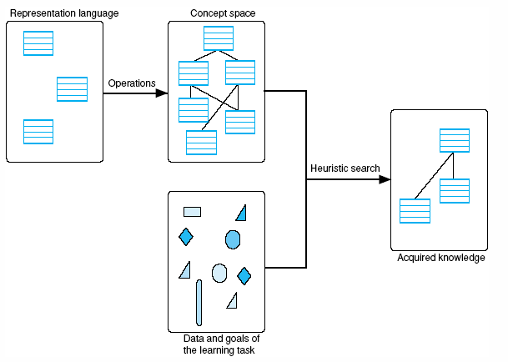
A general model of the learning process
Luger: Artificial Intelligence, 5th edition. © Pearson Education Limited, 2005

Slide 3
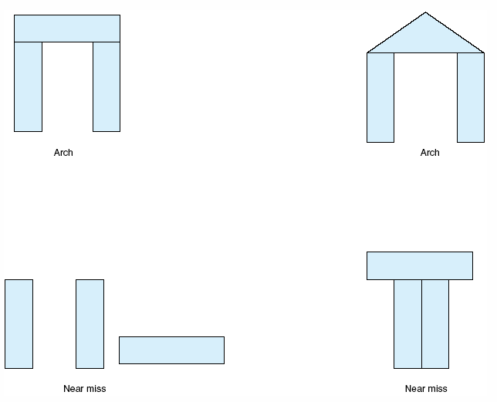
Examples and near misses for the concept “arch.”
Luger: Artificial Intelligence, 5th edition. © Pearson Education Limited, 2005

Slide 4
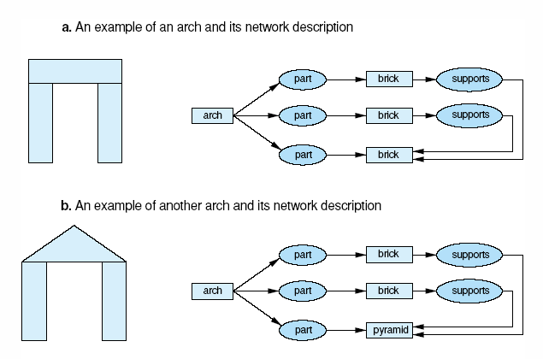
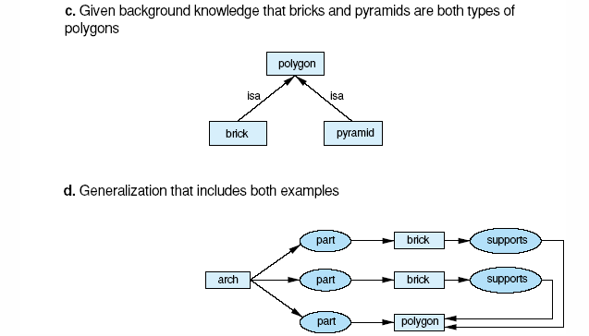
Generalization of descriptions to include multiple examples.
Luger: Artificial Intelligence, 5th edition. © Pearson Education Limited, 2005

Slide 5
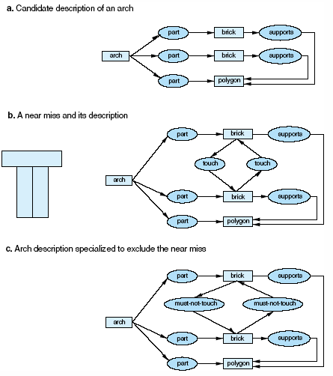
Specialization of a description to exclude a near miss. In c, constraints are added to a so that it can’t match with b.
Luger: Artificial Intelligence, 5th edition. © Pearson Education Limited, 2005

Slide 6
Version Spaces
Representation language for cars
origin ∈ {Japan, USA, Britain, Germany, Italy}
manufacturer ∈ {Honda, Toyata, Ford, Chrysler, Jaguar, BMW, Fiat}
color ∈ {Blue, Green, Red, White}
decade ∈ {1950, 1960, 1970, 1980, 1990, 2000}
type ∈ {Economy, Luxury, Sports}
An example of the concept “car” The concept “Japanese economy car”
origin: Japan Japan
manufacturer: Honda x₁
color: Blue x₂
decade: 1970 x₃
type: Economy Economy
Rich and Knight (1991), Artificial Intelligence

Slide 7
Partial ordering of concepts specified by the representation language
(x₁, x₂, x₃, x₄, x₅)
(Japan, x₂, x₃, x₄, x₅) (x₁, x₂, x₃, x₄, Economy)
(Japan, x₂, x₃, x₄, Economy) (USA, x₂, x₃, x₄, Economy)
… …
(Japan, Honda, White, 1980, Economy) (USA, Chrysler, Red, 1980, Economy)
Rich and Knight (1991), Artificial Intelligence

Slide 8
Concepts and Versions Spaces
Null Hypothesis
G
Version Space Concept Space
S
Training Examples
Note: G and S are subsets of the version space. G has the most general descriptions consistent with the training examples seen so far and S has the most specific descriptions consistent with those training examples.
Rich and Knight (1991), Artificial Intelligence

Slide 9
Candidate Elimination Algorithm
Given: a representation language and a set of positive and negative examples expressed in that language.
Compute: A concept description that is consistent with all the positive examples and none of the negative examples
Rich and Knight (1991), Artificial Intelligence

Slide 10
Candidate Elimination Algorithm
Initialize G to contain one element: the null description (all features are variables).
Initialize S to contain one element: the first positive example.
Accept a new training example.
If the training example is a positive instance
  Remove from G any descriptions that do not cover the example.
  Generalize S: Update S to contain the most specific set of descriptions in the version space that cover the example and the current elements of S (i.e., generalize the elements of S as little as possible so that they cover the new training example).
If the training example is a negative instance
  Remove from S any descriptions that cover the example.
  Specialize G: Update G to contain the most general set of descriptions in the version space that do not cover the example (i.e., specialize the elements of G as little as possible so that the negative example is no longer covered by any elements of G).
If S and G are not both singleton sets, go to step 3
If S and G are identical, output their value
If S and G are not identical, output their values and indicate that the training cases are inconsistent.
Halt
Rich and Knight (1991), Artificial Intelligence

Slide 11
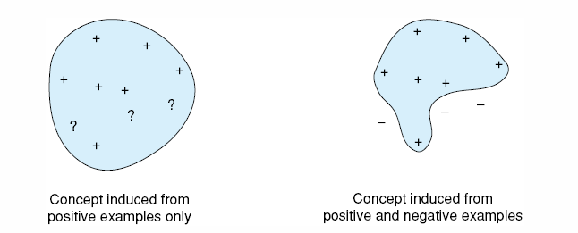
The role of negative examples in preventing overgeneralization.
Luger: Artificial Intelligence, 5th edition. © Pearson Education Limited, 2005

Slide 12
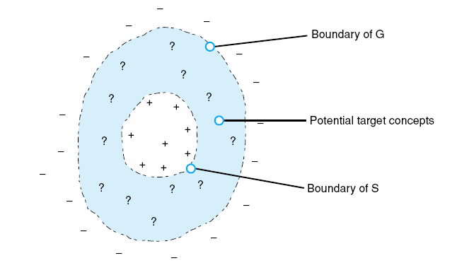
Converging boundaries of the G and S sets in the candidate elimination algorithm.
Luger: Artificial Intelligence, 5th edition. © Pearson Education Limited, 2005

Slide 13
Candidate Elimination Algorithm
Initialize G to contain one element: the null description (all features are variables).
Initialize S to contain one element: the first positive example.
Accept a new training example.
If the training example is a positive instance
  Remove from G any descriptions that do not cover the example.
  Generalize S: Update S to contain the most specific set of descriptions in the version space that cover the example and the current elements of S (i.e., generalize the elements of S as little as possible so that they cover the new training example).
If the training example is a negative instance
  Remove from S any descriptions that cover the example.
  Specialize G: Update G to contain the most general set of descriptions in the version space that do not cover the example (i.e., specialize the elements of G as little as possible so that the negative example is no longer covered by any elements of G).
If S and G are not both singleton sets, go to step 3
If S and G are identical, output their value
If S and G are not identical, output their values and indicate that the training cases are inconsistent.
Halt
(x1, x2, x3, x4, x5)
G
Version Space
Concept Space
S
(Japan, Honda, Blue, 1980, Economy) +
(Japan, Toyota, Green, 1970, Sports) –
(Japan, Toyota, Blue, 1990, Economy) +
(USA, Chrysler, Red, 1980, Economy) –
(Japan, Honda, White, 1980, Economy) +
Positive and negative examples of the concept “Japanese economy car”
Rich and Knight (1991), Artificial Intelligence

Slide 14
Tracing the Candidate Elimination Algorithm
Positive and negative examples of the concept “Japanese economy car”
(Japan, Honda, Blue, 1980, Economy) +
(Japan, Toyota, Green, 1970, Sports) –
(Japan, Toyota, Blue, 1990, Economy) +
(USA, Chrysler, Red, 1980, Economy) –
(Japan, Honda, White, 1980, Economy) +
Step A: TE = (Japan, Honda, Blue, 1980, Economy) +
(initialize) G = {(x1, x2, x3, x4, x5)}
S = {(Japan, Honda, Blue, 1980, Economy)}
Step B: TE = (Japan, Toyota, Green, 1970, Sports) –
G = {(x1, Honda, x3, x4, x5), (x1, x2, Blue, x4, x5),
(x1, x2, x3, 1980, x5), (x1, x2, x3, x4, Economy)}
S = {(Japan, Honda, Blue, 1980, Economy)}
Step C: TE = (Japan, Toyota, Blue, 1990, Economy) +
G = {(x1, x2, Blue, x4, x5), (x1, x2, x3, x4, Economy)}
S = {(Japan, x2, Blue, x4, Economy)}
Step D: TE = (USA, Chrysler, Red, 1980, Economy) –
G = {( x1, x2, Blue, x4, x5), (Japan, x2, x3, x4, Economy)}
S = {(Japan, x2, Blue, x4, Economy)}
Step E: TE = (Japan, Honda, White, 1980, Economy) +
G = {(Japan, x2, x3, x4, Economy)}
S = {(Japan, x2, x3, x4, Economy)}
Note: TE = “Training Example”
Initialize G to contain one element: the null description (all features are variables).
Initialize S to contain one element: the first positive example.
Accept a new training example.
If the training example is a positive instance
  Remove from G any descriptions that do not cover the example.
  Generalize S: Update S to contain the most specific set of descriptions in the version space that cover the example and the current elements of S (i.e., generalize the elements of S as little as possible so that they cover the new training example).
If the training example is a negative instance
  Remove from S any descriptions that cover the example.
  Specialize G: Update G to contain the most general set of descriptions in the version space that do not cover the example (i.e., specialize the elements of G as little as possible so that the negative example is no longer covered by any elements of G).
If S and G are not both singleton sets, go to step 3
If S and G are identical, output their value
If S and G are not identical, output their values and indicate that the training cases are inconsistent.
Halt
Rich and Knight (1991), Artificial Intelligence

Slide 15
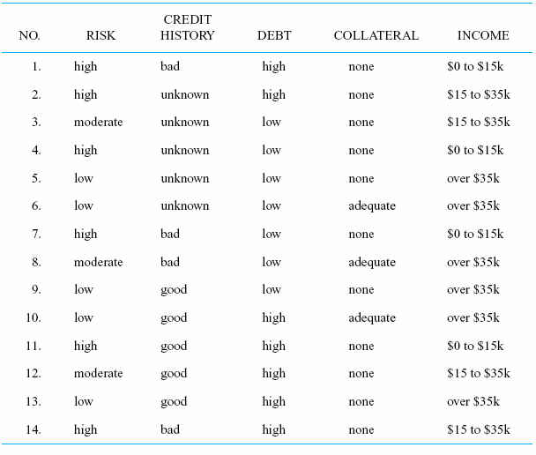
Decision Tree Formation
properties
class
values
Luger: Artificial Intelligence, 5th edition. © Pearson Education Limited, 2005

Slide 16
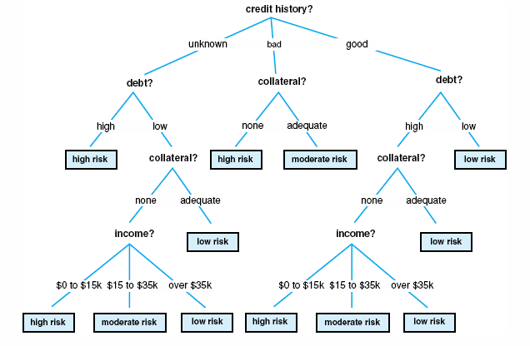
A decision tree for credit risk assessment.
How do we build such a tree?
Luger: Artificial Intelligence, 5th edition. © Pearson Education Limited, 2005

Slide 17
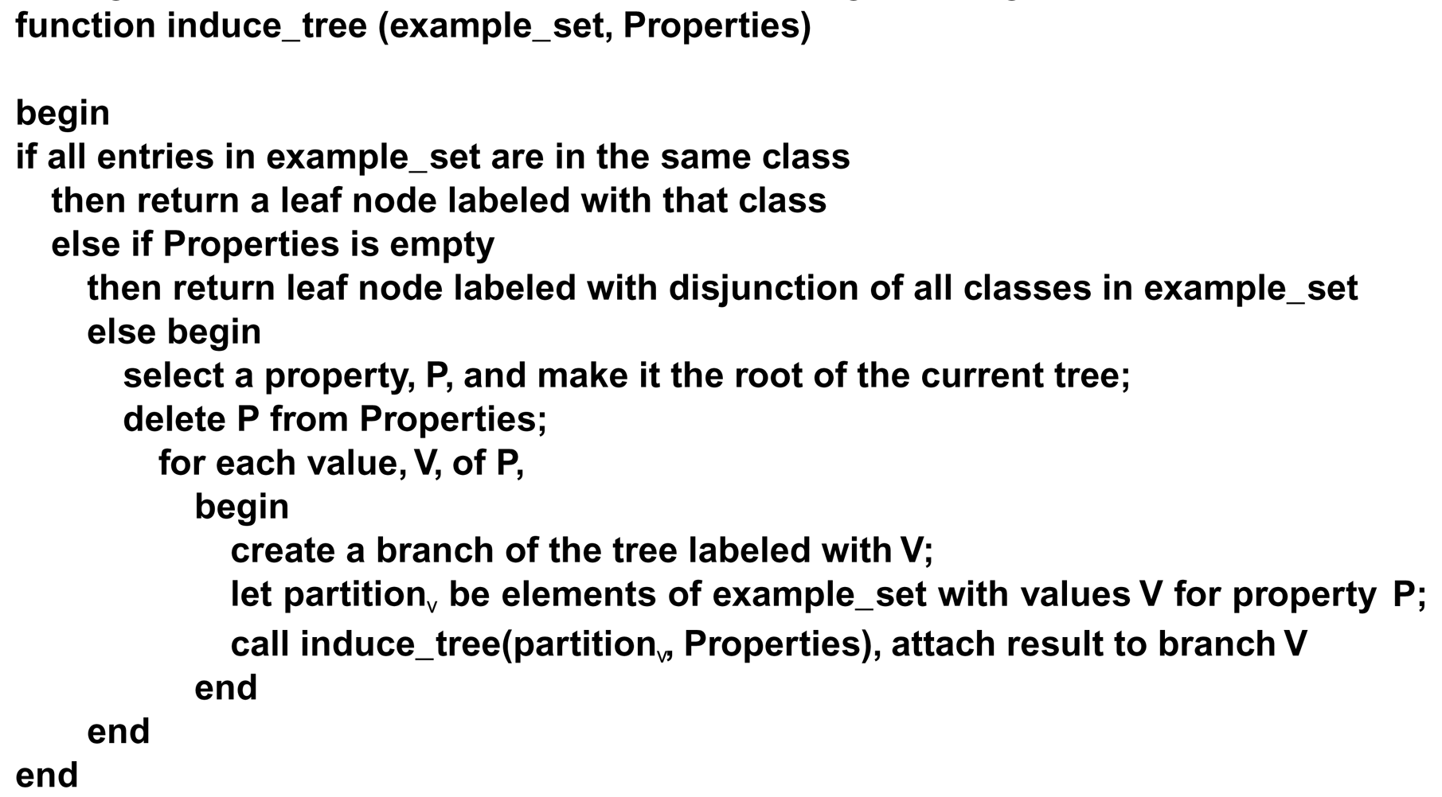
The induction algorithm begins with a sample of correctly classified members of the target categories. ID3 constructs a decision tree according to the algorithm:
Luger: Artificial Intelligence, 5th edition. © Pearson Education Limited, 2005

Slide 18
A partially constructed decision tree.
Luger: Artificial Intelligence, 5th edition. © Pearson Education Limited, 2005

Slide 19
A partially constructed decision tree.
examples {1,2,3,4,5,6,7,8,9,10,11,12,13,14}
Luger: Artificial Intelligence, 5th edition. © Pearson Education Limited, 2005

Slide 20

A partially constructed decision tree (continued)
examples {1,2,3,4,5,6,7,8,9,10,11,12,13,14}
Luger: Artificial Intelligence, 5th edition. © Pearson Education Limited, 2005

Slide 21
A partially constructed decision tree (continued)
examples {2,3,4,5,6}
examples {1,7,8,14}
examples {9,10,11,12,13}
Luger: Artificial Intelligence, 5th edition. © Pearson Education Limited, 2005

Slide 22

A partially constructed decision tree (continued)
{2,3,4,5,6}
{1,7,8,14}
{9,10,11,12,13}
Luger: Artificial Intelligence, 5th edition. © Pearson Education Limited, 2005

Slide 23
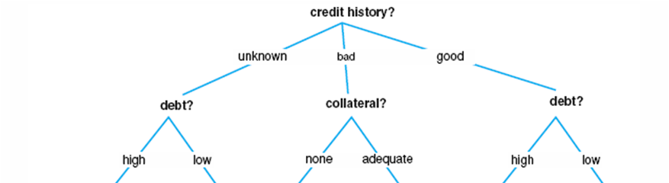
A partially constructed decision tree (continued)
{2,3,4,5,6}
{1,7,8,14}
{9,10,11,12,13}
{2}
{3,4,5,6}
{1,7,14}
{8}
{10,11,12,13}
{9}
Luger: Artificial Intelligence, 5th edition. © Pearson Education Limited, 2005

Slide 24
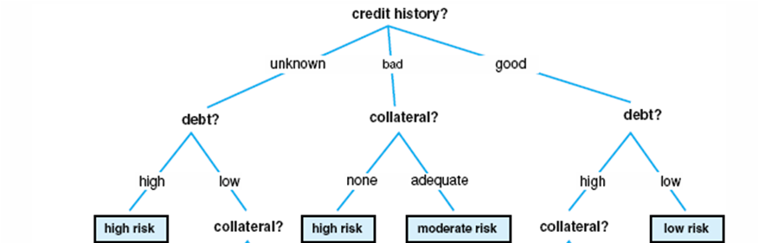
A partially constructed decision tree (continued)
{2,3,4,5,6}
{1,7,8,14}
{9,10,11,12,13}
{2}
{3,4,5,6}
{1,7,14}
{8}
{10,11,12,13}
{9}
Luger: Artificial Intelligence, 5th edition. © Pearson Education Limited, 2005

Slide 25
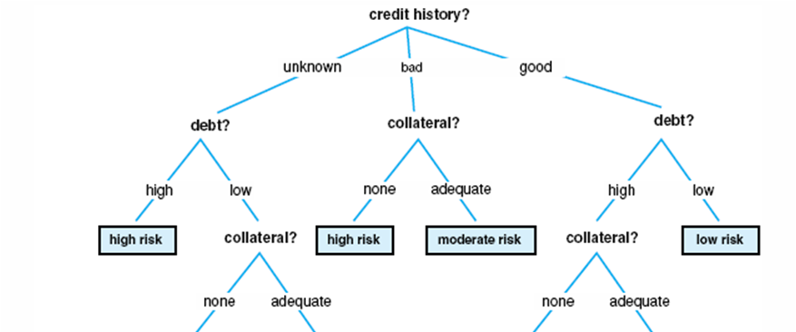
A partially constructed decision tree (continued)
{2,3,4,5,6}
{1,7,8,14}
{9,10,11,12,13}
{2}
{3,4,5,6}
{1,7,14}
{8}
{10,11,12,13}
{9}
{3,4,5}
{6}
{11,12,13}
{10}
Luger: Artificial Intelligence, 5th edition. © Pearson Education Limited, 2005

Slide 26
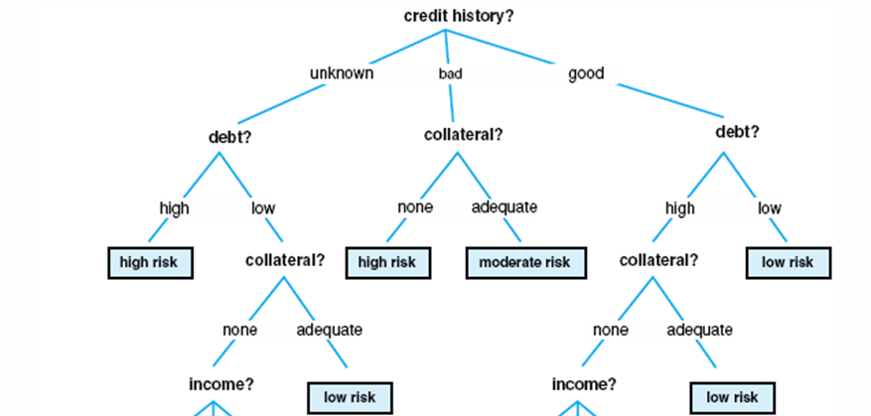
A partially constructed decision tree (continued)
{2,3,4,5,6}
{1,7,8,14}
{9,10,11,12,13}
{2}
{3,4,5,6}
{1,7,14}
{8}
{10,11,12,13}
{9}
{3,4,5}
{6}
{11,12,13}
{10}
Luger: Artificial Intelligence, 5th edition. © Pearson Education Limited, 2005

Slide 27
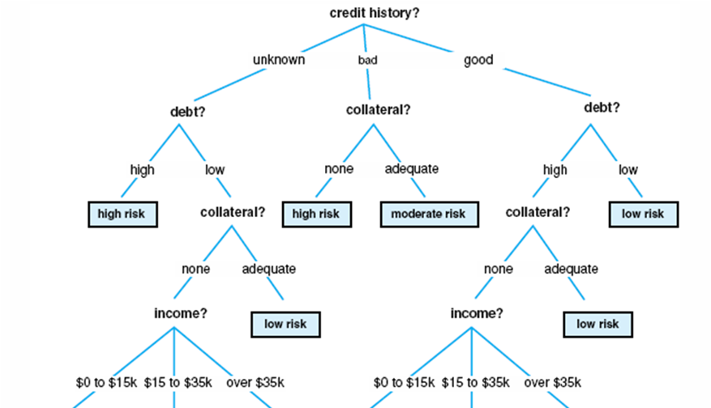
A partially constructed decision tree (continued)
{2,3,4,5,6}
{1,7,8,14}
{9,10,11,12,13}
{2}
{3,4,5,6}
{1,7,14}
{8}
{10,11,12,13}
{9}
{3,4,5}
{6}
{11,12,13}
{10}
{4}
{3}
{5}
{11}
{12}
{13}
Luger: Artificial Intelligence, 5th edition. © Pearson Education Limited, 2005

Slide 28
The completed decision tree
{2,3,4,5,6}
{1,7,8,14}
{9,10,11,12,13}
{2}
{3,4,5,6}
{1,7,14}
{8}
{10,11,12,13}
{9}
{3,4,5}
{6}
{11,12,13}
{10}
{4}
{3}
{5}
{11}
{12}
{13}
Luger: Artificial Intelligence, 5th edition. © Pearson Education Limited, 2005

Slide 29
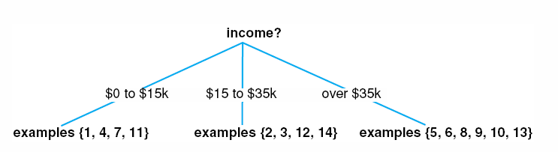
An alternative sequence: A partially constructed decision tree
Luger: Artificial Intelligence, 5th edition. © Pearson Education Limited, 2005

Slide 30
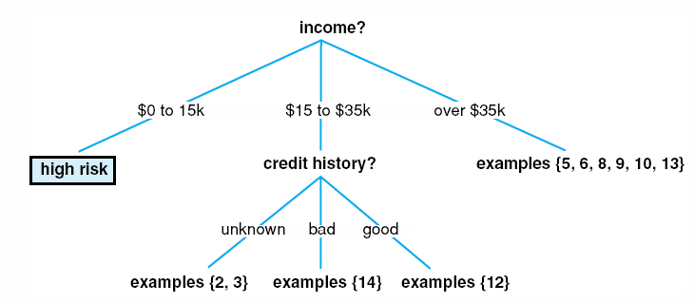
An alternative sequence: A partially constructed decision tree (continued)
Luger: Artificial Intelligence, 5th edition. © Pearson Education Limited, 2005

Slide 31
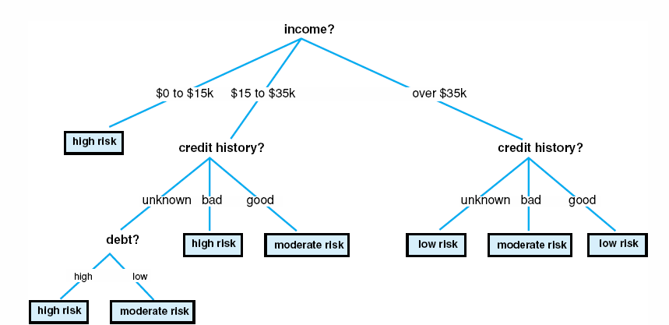
Completed decision tree for the alternative sequence
A simplified decision tree for credit risk assessment.
Compare…
Luger: Artificial Intelligence, 5th edition. © Pearson Education Limited, 2005

Slide 32
The induction algorithm begins with a sample of correctly classified members of the target categories. ID3 constructs a decision tree according to the algorithm:
Information theoretic test selection
Luger: Artificial Intelligence, 5th edition. © Pearson Education Limited, 2005

Slide 33
Information Theoretic Test Selection
Expected information content of a message M (from a universe of messages {m₁, m₂, … , m_{n}} with probability p(m_{i}) for each m_{i} is
I[M] = – Σ p(m_{i})log₂p(m_{i})

Slide 34
A Brief Aside…
Entropy: 1. For a closed thermodynamic system, a quantitative measure of the amount of thermal energy not available to do work. 2. A measure of the disorder or randomness in a closed system. 3. A measure of the loss of information in a transmitted message.
Second law of thermodynamics: entropy of a closed system can never decrease.
Entropy associated with a thermal state is S = – k Σ_{i} p_{i} ln(p_{i})(k is Boltzmann’s constant ≈ 1.38 × 10^{–23} joule/°Kelvin).
Entropy associated with a traditional Boolean logic gate is H = – Σ_{i} p_{i} log(p_{i}) where p is the probability of occurrence of an input or output state (Shannon’s formula).
For example, consider the increase in entropy when using an XOR gate:
The probability distribution for inputs is 1/4 for each possibility (00, 01, 10, 11), so
H_{initial} = – Σ_{i=1 to 4} p_{i} log(p_{i}) = – 4(1/4 log 1/4) = – 4(1/4 * (–2)) = 2 bits
(i.e., it takes two bits to represent the four possible input states)
The probability distribution for outputs is 1/2 for each possibility (i.e., 2 inputs produce 0 and 2 inputs produce 1), so
H_{final} = –(1/2 log 1/2 + 1/2 log 1/2) = or 1 bit
(i.e., it takes one bit to represent the two possible output states).
Change in entropy is H_{initial} – H_{final} = 2 – 1 = 1 bit = loss of information (i.e., increase in uncertainty) associated with operation of the gate.
The two notions of entropy are equivalent (Von Neumann).
Changing the probability distribution so as to increase entropy H by 1 bit increases S by k ln (2) joule/°Kelvin and k ln (2) joules is dissipated in the form of heat.
Landauer’s principle: erasure of information is a dissipative process (i.e., requires energy; generates heat; increases entropy)

Slide 35
From the table (and assuming that all examples occur with equal probability):
p(high risk) = 6/14
p(moderate risk) = 3/14
p(low risk) = 5/14
I[M] = – Σ p(m_{i})log₂p(m_{i})
The information content in the table (using the risk property) is therefore:
I(table) = – 6/14 log₂(6/14) – 3/14 log₂(3/14) – 5/14 log₂(5/14) = 1.531 bits
Recall that log_{x}y = log_{z}y/log_{z}x. For example, log₂64 = log₁₀64/log₁₀2 = 1.806/.301 = 6.
Luger: Artificial Intelligence, 5th edition. © Pearson Education Limited, 2005

Slide 36
We must determine which property should be used for the test at the root. This is done by computing the total information in the tree (I(table)) minus the amount of info needed to complete the classification after performing the test. This latter figure is the weighted average of the information in all its sub-trees.
This weighted average (i.e., expected information to complete the tree after making P the root) = sum of the products of the information content of each sub-tree times the fraction of examples in that sub-tree.
E[P] = Σ I[C_{i}] ( |C_{i}| / |C| )
The gain from property P is computed as:
gain(P) = I[C] – E[P]
Note that C is a set of training instances and if property P (with n values) is made the root of the current tree, C is partitioned into the subsets {C₁, C₂, … , C_{n}} .
Luger: Artificial Intelligence, 5th edition. © Pearson Education Limited, 2005

Slide 37
E[P] = Σ I[C_{i}] ( |C_{i}| / |C| )
gain(P) = I[C] – E[P]
I[M] = Σ –p(m_{i})log₂p(m_{i})
Consider the “income” property:
Let C₁ = be examples of income from $0 to $15k, C₂ from $15k to $35k, C₃ over $35k
C₁ = {1, 4, 7, 11}, C₂ = {2, 3, 12, 14}, C₃ = {5, 6, 8, 9, 10, 13}
E[income] = 4/14 I[C₁] + 4/14 I[C₂] + 6/14 I[C₃] =
4/14 (– 4/4log₂4/4) + 4/14 (– 2/4log₂2/4– 2/4log₂2/4) + 6/14 (– 5/6log₂5/6– 1/6log₂1/6) =
4/14(0) + 4/14(1) + 6/14(.65) = .564 bits
gain(income) = I[table] – E[income] = 1.531 – .564 = .967 bits
Luger: Artificial Intelligence, 5th edition. © Pearson Education Limited, 2005

Slide 38
E[P] = Σ I[C_{i}] ( |C_{i}| / |C| )
gain(P) = I[C] – E[P]
Consider the “credit history” property:
Let C₁ = be examples of bad history, C₂ of unknown, C₃ of good
C₁ = {1, 7, 8, 14}, C₂ = {2, 3, 4, 5, 6}, C₃ = {9, 10, 11, 12, 13}
E[credit history] = 4/14 I[C₁] + 5/14 I[C₂] + 5/14 I[C₃] =
4/14 (– 3/4log₂3/4– 1/4log₂1/4) + 5/14 (– 2/5log₂2/5– 1/5log₂1/5 – 2/5log₂2/5) +
5/14 (– 3/5log₂3/5– 1/5log₂1/5 – 1/5log₂1/5) =
4/14(.811) + 5/14(1.522) + 5/14(1.371) = 1.265 bits
gain(credit history) = I[table] – E[credit history] = 1.531 – 1.265 = .266 bits
Luger: Artificial Intelligence, 5th edition. © Pearson Education Limited, 2005

Slide 39
E[P] = Σ I[C_{i}] ( |C_{i}| / |C| )
gain(P) = I[C] – E[P]
Consider the “debt” property:
Let C₁ = be examples of high debt, C₂ of low debt
C₁ = {1, 2, 10, 11, 12, 13, 14}, C₂ = { 3, 4, 5, 6, 7, 8, 9}
E[debt] = 7/14 I[C₁] + 7/14 I[C₂] =
7/14 (– 4/7log₂4/7– 1/7log₂1/7–2/7log2/7) + 7/14 (– 2/7log₂2/7– 2/7log₂2/7 – 3/7log₂3/7) =
7/14(1.379) + 7/14(1.557) = 1.468 bits
gain(debt) = I[table] – E[debt] = 1.531 – 1.468 = .063 bits
Luger: Artificial Intelligence, 5th edition. © Pearson Education Limited, 2005

Slide 40
E[P] = Σ I[C_{i}] ( |C_{i}| / |C| )
gain(P) = I[C] – E[P]
After further calculations we have the following results:
gain(income) = .967
gain(credit history) = .266
gain(debt) = .063
gain(collateral) = .206
Because the information gain for the income property is largest, we make it the root node of the tree.
Luger: Artificial Intelligence, 5th edition. © Pearson Education Limited, 2005

Slide 41
A partially constructed decision tree.
Note that this node will be labeled “High” because all examples are in that class
The process is repeated recursively for each sub-tree…
Luger: Artificial Intelligence, 5th edition. © Pearson Education Limited, 2005

Slide 42
Example: Select a property for the center branch
Compute information content of “$15k to $35k” sub-tree (uses examples {2, 3, 12, 14}):
I[$15k to $35k sub-tree] = – 2/4log₂2/4 – 2/4log₂2/4 = 1bit
Now compute E[P] for each property (not yet used in an ancestor node).
e.g., if we consider “credit history” as a possible root (of the sub-tree), it partitions the items from the set {2, 3, 12, 14} into C₁ = {2, 3}, C₂ = {12}, C₃ = {14}.
E[credit history] = 2/4 I[C₁] + 1/4 I[C₂] + 1/4 I[C₃] =
2/4 (– 1/2log₂1/2 – 1/2log₂1/2) + 1/4(– 1*log₂1 ) + 1/4(– 1*log₂1 ) = .5
Similarly, compute E[P] values for debt and collateral and select the property with the highest information gain to be the node of the current sub-tree. In this case it is credit history.
Note that the “bad” and “good” branches immediately yield leaf nodes for the anticipated risk. The “unknown” branch must be further processed, however.
Luger: Artificial Intelligence, 5th edition. © Pearson Education Limited, 2005

Slide 43
Example: Select a property for the “unknown” credit history branch
Compute information content of “unknown” sub-tree (uses examples {2, 3}):
I[“unknown” credit history sub-tree] = – 1/2log₂1/2 – 1/2log₂1/2 = 1bit
Now compute E[P] for each property (not yet used in an ancestor node). If we consider “debt” as a possible root (of the sub-tree), it partitions items from set {2, 3} into C₁ = {2} and C₂ = {3}.
E[debt] = 1/2 I[C₁] + 1/2 I[C₂] = 1/2 (– 1*log₂1) + 1/2(– 1*log₂1 ) = 0
“Collateral” partitions items from set {2, 3} into C₁ = {2,3}.
E[collateral] = 2/2* I[C₁] = 1* (– 1/2*log₂1/2 – 1/2*log₂1/2 ) = 1
Select the property with the highest information gain to be the node of the current sub-tree. In this case it is debt, because
gain(debt) =
I[“unknown” credit history] – E[debt]
is greater than
gain(collateral) =
I[“unknown” credit history] – E[collateral]. .
Luger: Artificial Intelligence, 5th edition. © Pearson Education Limited, 2005

Slide 44
The final tree…
Luger: Artificial Intelligence, 5th edition. © Pearson Education Limited, 2005

Slide 45
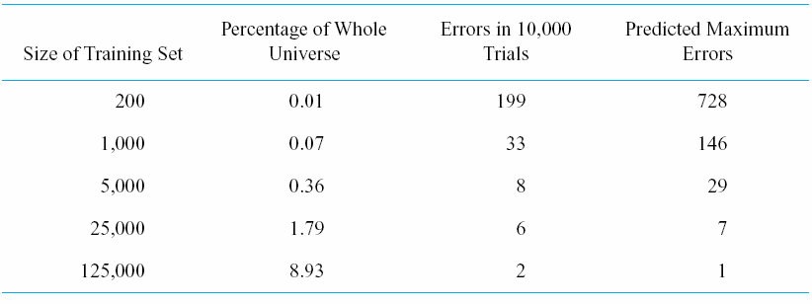
The evaluation of ID3 (learning to classify boards in a chess endgame)
Luger: Artificial Intelligence, 5th edition. © Pearson Education Limited, 2005

Slide 46
Potential Problems for ID3
Bad data (e.g. multiple attributes give different results)
Missing data (is extrapolation a valid option?)
Continuous attributes (what is the best way to put continuous data into discrete categories?)
Too much data (e.g., learning algorithm performance may scale poorly if too many properties)
Possible Approaches
Bagging: produce replicate training sets by sampling with replacement from the training instances
Boosting: use all training instances at each replication but with a weight for each training instance (to reflect its importance). Different weights produce different classifiers.
Luger: Artificial Intelligence, 5th edition. © Pearson Education Limited, 2005

Slide 47
Can use the tree to construct a rule set…
Procedure
Each path = a single rule
Antecedent is composed decisions leading to a leaf node
Consequent is leaf node
Example
($15k < income < $35k) ∧ (credit history = unknown) ∧ (debt = low) → moderate risk
Luger: Artificial Intelligence, 5th edition. © Pearson Education Limited, 2005

Slide 48
Inductive Bias
(any criteria a learner uses to constrain the concept space or to select concepts within that space)
Must prune learning space for tractability
  e.g., for m binary strings there are ℘(m) = 2^{m} different classifications (i.e., {∅, {a}, {b}, …, {a,b}, …, {b,c}, …, {a,b,c}, …{a,b,c,d,…}} where a, b, etc. are strings)
  e.g., for all possible n-bit binary strings there are x = 2^{n} different strings and 2^{x} possible classifications.
Training data set may support many generalizations (e.g., consider {1010,1100}).
Generalization is not necessarily truth-preserving.
Bias may take form of
  heuristics for choosing branch of search space (e.g., ID3’s information theoretic test selection).
  syntactic constraints on representation of learned concepts (e.g., “1##0” to define members {1000, 1010, 1100, 1110}).
  Domain specific knowledge
Note the potential for trade-offs between expressiveness and efficiency
Luger: Artificial Intelligence, 5th edition. © Pearson Education Limited, 2005

Slide 49
Analogical Reasoning
A typical framework for computational models:
Retrieval
  Given a target problem, select a potential source analog. Must select features of target and source that increase likelihood of retrieving a useful source analog. Must index knowledge according to those features.
Elaboration
  After retrieving source, derive additional features and relation of the source.
Mapping and inference
  Map the source attributes into the target domain. (Involves both known similarities and analogical inferences.)
Justification
  Verify that the mapping is valid. (May require mapping modification.)
Learning
  Store the acquired knowledge in a form that will be useful in the future.
Luger: Artificial Intelligence, 5th edition. © Pearson Education Limited, 2005

Slide 50
Structure Mapping (Gentner)
Sample source domain predicates:
  yellow(sun)
  blue(earth)
  hotter-than(sun,earth)
  causes(more-massive(sun,earth),attracts(sun,earth))
  causes(attract(sun,earth),revolves-around(earth,sun))
Target domain the analogy is intended to explain:
  more-massive(nucleus,electron)
  revolves-around(electron,nucleus)
Luger: Artificial Intelligence, 5th edition. © Pearson Education Limited, 2005

Slide 51
Structure Mapping (Gentner)
(continued)
Structure mapping attempts to transfer the causal structure of the source to the target. The mapping is constrained by the following rules:
  Superficial properties are dropped from the source (e.g., unary predicates).
  Relations map unchanged from the source to the target (although the arguments may differ).
  Higher-order relations are preferred as a focus of the mapping (e.g., causes() is higher order because it has other relations as arguments).
In the example, these constraints lead to the mapping
  sun → nucleus
  earth → electron
Extending the mapping leads to the inference
  causes(more-massive(nucleus, electron), attract(nucleus, electron))
  causes(attract(nucleus, electron)), revolves-around(electron, nucleus))
Luger: Artificial Intelligence, 5th edition. © Pearson Education Limited, 2005

Slide 52
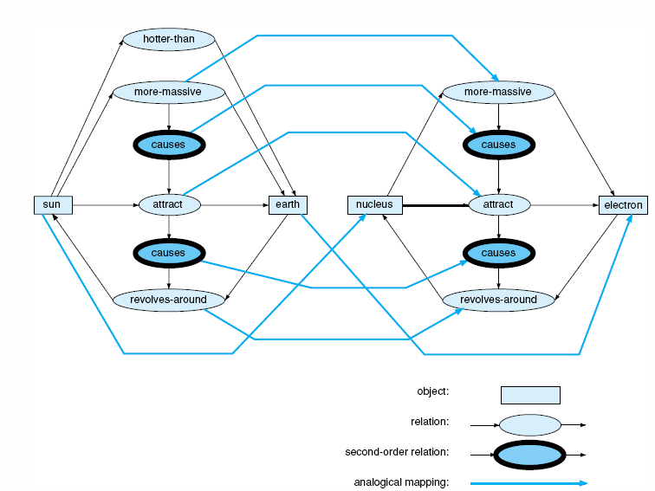
An analogical mapping
But consider Chalmers’, French’s, and Hofstadter’s criticisms (in Fluid Concepts and Creative Analogies (pp. 179-185)…
Luger: Artificial Intelligence, 5th edition. © Pearson Education Limited, 2005

Slide 53
Some Desirable Characteristics of AI Memory Systems
Stable
Plastic
High capacity
Fast
Generalizing
Capable of distinguishing between similar patterns
Content addressable

